Slide 1
Reminders
Homework 8 due Date Tonight by 11:59pm
I distributed data for HW9 for everyone who completed IRB training
Quiz on Chapters 15&16 will be released Later this week.

Slide 2
Information Extraction
Jurafsky and Martin Chapter 18
Notes:
Stanford Question Answering Dataset (SQuAD) consists of passages from Wikipedia and associated questions whose answers are spans from the passage, for just over150,000 questions.

Slide 3
Information Extraction (IE)
Information extraction (IE), turns the unstructured text information into structured data
Populate a relational database to enable further processing, support queries
Notes:
Example of building semantic reprentation:
What states border Texas? → ƛx:state(x)^borders(x; texas),
When was Ada Lovelace born? → birth-year (Ada Lovelace, ?x).

Slide 4
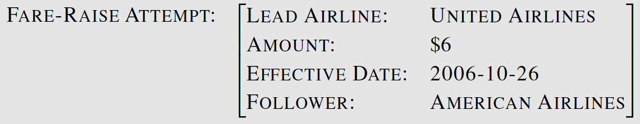
Template Filling
Citing high fuel prices, United Airlines said Friday it has increased fares by $6 per round trip on flights to some cities also served by lower cost carriers. American Airlines, a unit of AMR Corp., immediately matched the move, spokesman Tim Wagner said. United, a unit of UAL Corp., said the increase took effect Thursday and applies to most routes where it competes against discount carriers, such as Chicago to Dallas and Denver to San Francisco.

Slide 5
Steps in IE
NER and co-reference resolution
relation extraction
spouse-of, child-of, employer-of, partof, membership-in, located-in
event extraction
temporal expression normalization
template filling

Slide 6
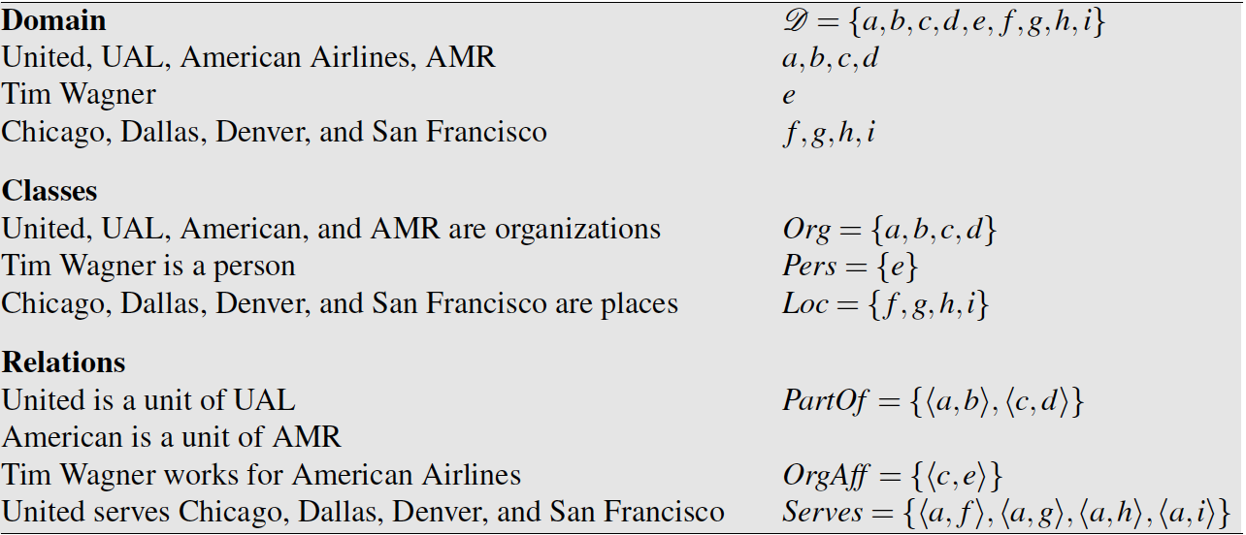
Relation Extraction
A relation consists of a set of ordered tuples over elements of a domain
The domain elements corresponds to the named entities

Slide 7
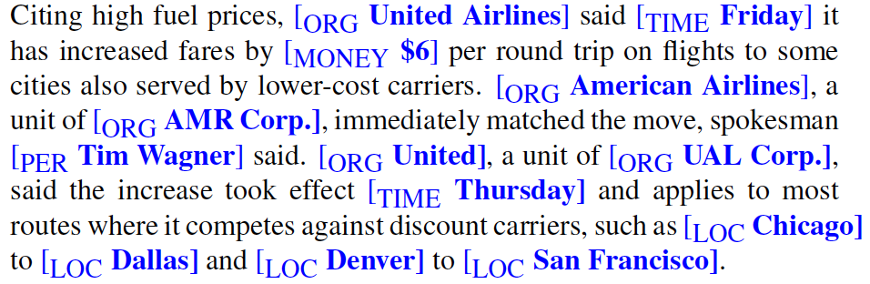
Tim Wagner [is a spokesman] for American Airlines.
United [is a unit of] UAL Corp.
American [is a unit of] AMR.

Slide 8
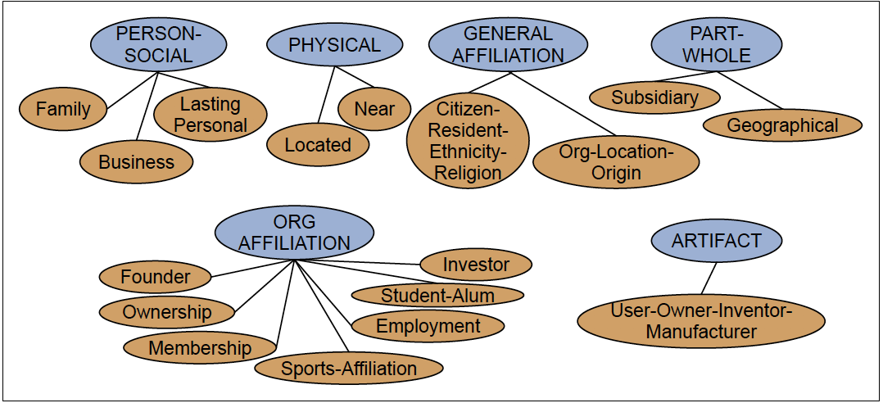
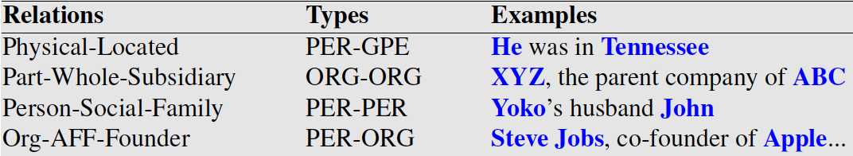

Slide 9
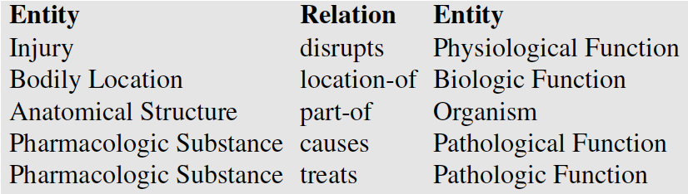
Unified Medical Language System
Given a medical sentence like:
Doppler echocardiography can be used to diagnose left anterior descending artery stenosis in patients with type 2 diabetes
Extract the UMLS relation:
Echocardiography (Doppler) Diagnoses Acquired stenosis

Slide 10
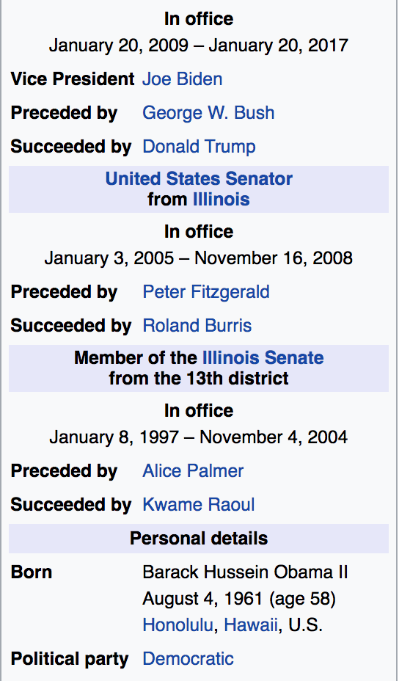
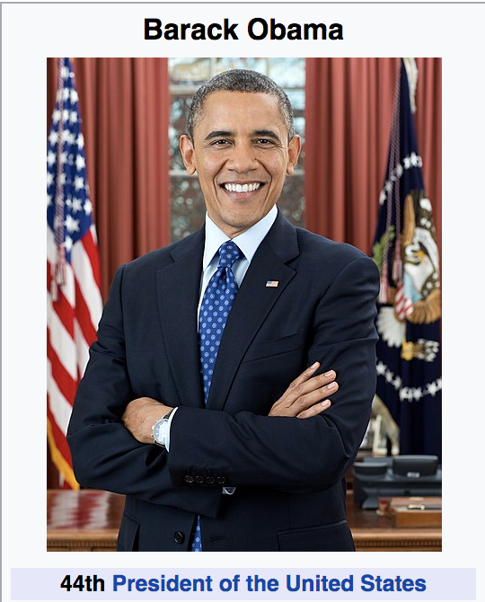
Wikipedia info boxes

Slide 11
RDF Triples
Resource Description Framework
RDF triple is a tuple of
Entity-relation-entity, aka
Subject-predicate-object expression
Subject: University of Pennsylvania
Predicate: location
Object: Philadelphia, PA

Slide 12
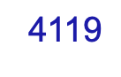
DBpedia is a community effort to extract structured information from Wikipedia and to make this information available on the Web. DBpedia allows you to ask sophisticated queries against datasets derived from Wikipedia and to link other datasets on the Web to Wikipedia data. We describe the extraction of the DBpedia datasets, and how the resulting information is published on the Web for human-and machine-consumption. We describe some emerging applications from the DBpedia community and show how website authors can facilitate DBpedia content within their sites. Finally, we present the current status of interlinking DBpedia with other open datasets on the Web and outline how DBpedia could serve as a nucleus for an emerging Web of open data.

Slide 13
Freebase, WordNet, other ontologies
Freebase relations:
people/person/nationality
location/location/contains
people/person/place-of-birth
biology/organism classification
WordNet relations:
is-a, instance-of
hypernyms/hyponyms
Giraffe is-a ruminant is-a ungulate is-a mammal is-a vertebrate is-a animal…

Slide 14
Strategies for relation extraction
Hand-written patterns
Supervised machine learning
Semi-supervised machine learning
Bootstrapping
Distant supervision
Unsupervised machine learning

Slide 15
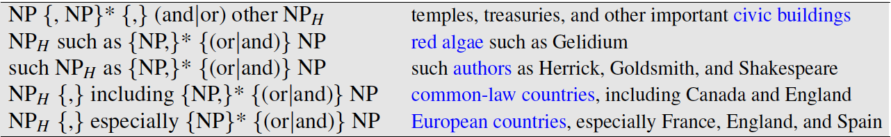
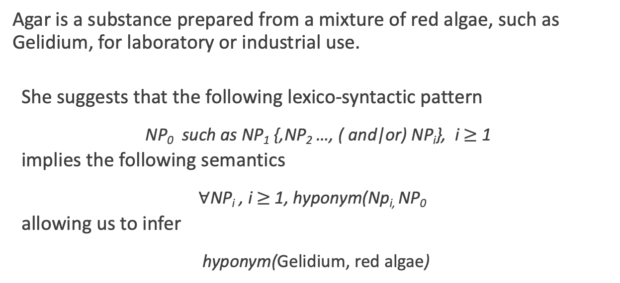
Hearst Patterns
Agar is a substance prepared from a mixture of red algae, such as Gelidium, for laboratory or industrial use.
She suggests that the following lexico-syntactic pattern
NP₀ such as NP₁ {,NP₂ …, ( and|or) NP_{i}}, i $≥$ 1
implies the following semantics
$∀$NP_{i} , i $≥$ 1, hyponym(Np_{i,} NP₀
allowing us to infer
hyponym(Gelidium, red algae)

Slide 16
Machine learning techniques
Supervised: training corpus annotated with manually annotated with fixed set of relations and entities
Semi-supervised: high-precision seed patters, or seed tuples, are used to bootstrap more examples
Distant supervision: start with a huge number of seeds, learn noisy pattern fields (e.g. 100k examples of birth-place-of from infoboxes, help learn the corresponding text patterns)

Slide 17
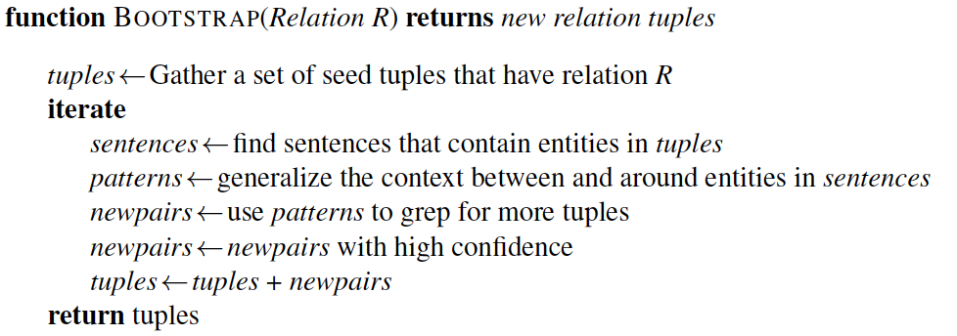
Semisupervised Relation Extraction
Bootstrapping proceeds by taking the entities in the seed pair, and then finding sentences (on the web, or whatever dataset we are using) that contain both entities.

Slide 18
Example
Task: Create airline/hub pairs
Seed: Ryanair has a hub at Charleroi
use this seed fact to discover new patterns by finding other mentions of this relation in our corpus
Sentences found:
Budget airline Ryanair, which uses Charleroi as a hub, scrapped all weekend flights out of the airport.
All flights in and out of Ryanair’s Belgian hub at Charleroi airport were grounded on Friday...
A spokesman at Charleroi, a main hub for Ryanair, estimated that 8000 passengers had already been affected.
Patterns extracted:
/ [ORG], which uses [LOC] as a hub /
/ [ORG]'s hub at [LOC] /
/ [LOC] a main hub for [ORG] /

Slide 19
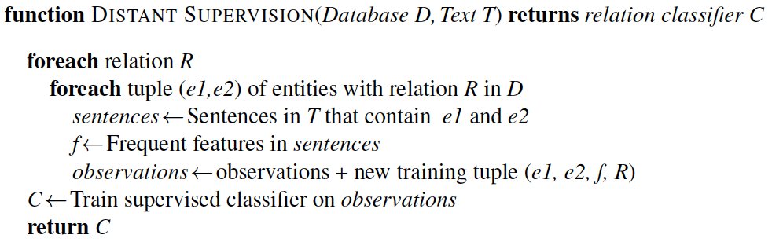
Distant Supervision
R: place of birth
(e1, e2): <Edwin Hubble, Marshfield>, <Albert Einstein,Ulm>, etc
Sentences: Hubble was born in Marshfield; Einstein, born (1879), Ulm; Hubble’s birthplace in Marshfield..., etc

Slide 20
Open IE
Unsupervised relation extraction
Find all strings of words that satisfy the tripe relation.
United has a hub in Chicago, which is the headquarters of United Continental Holdings.
r1: <United, has a hub in, Chicago>
r2: <Chicago, is the headquarters of, United Continental Holdings>

Slide 21
Evaluation of Relation Extraction
Supervised
Test sets with human annotated, gold-standard relations and computing precision, recall, and F-measure
Semi and Unsupervised
Human evaluations
Compute precision at different levels of recall

Slide 22
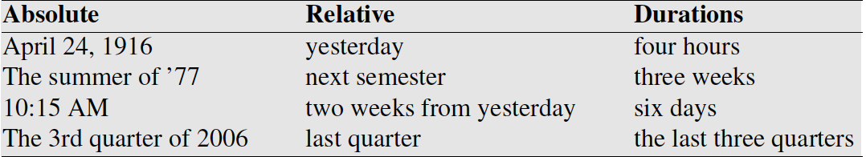
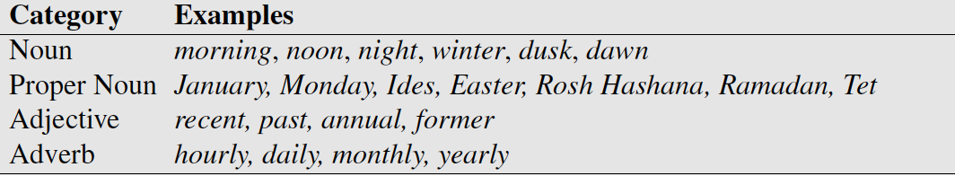
Temporal Expression Extraction
Lexical triggers for temporal expressions:
Temporal expression recognition
Temporal normalization
mapping a temporal expression to either normalization a specific point in time or to a duration
Notes:
Temporal normalization is the process of mapping a temporal expression to either a specific point in time or to a duration. Points in time correspond to calendar dates, to times of day, or both. Durations primarily consist of lengths of time but may also include information about start and end points.

Slide 23
Event Extraction
The task of event extraction is to identify mentions of events in texts. An event mention is any expression denoting an event or state that can be assigned to a point in time or an interval in time.
In English events are typically expressed verbs like exploded. However, there are also some nouns, like explosion, that denote an event.
Some “light verbs” like make, take, and have often do not denote events. Instead, the event is often expressed by the nominal direct object (took a flight).

Slide 24
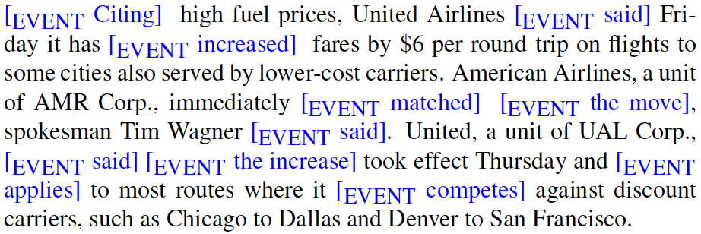
Event Extraction
Events can be classified as actions, states, reporting events, perception events, etc. The aspect, tense, and modality of each event also needs to be extracted.
Notes:
Reporting events:
Events are to be classified as actions, states, reporting events (say, report, tell, explain), perception events, and so on. The aspect, tense, and modality of each event also needs to be extracted.

Slide 25
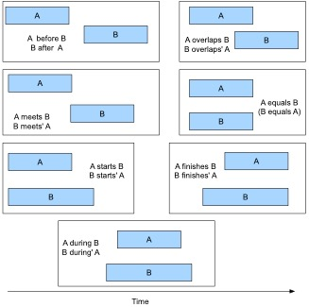

Slide 26
Temporal ordering of events
Delta Air Lines earnings soared 33% to a record in the fiscal first quarter, bucking the industry trend toward declining profits.
Soaring_{e1} is included in the fiscal first quarter_{t58}
Soaring_{e1} is simultaneous with the bucking_{e3}
Declining_{e4} includes soaring_{e1}

Slide 27
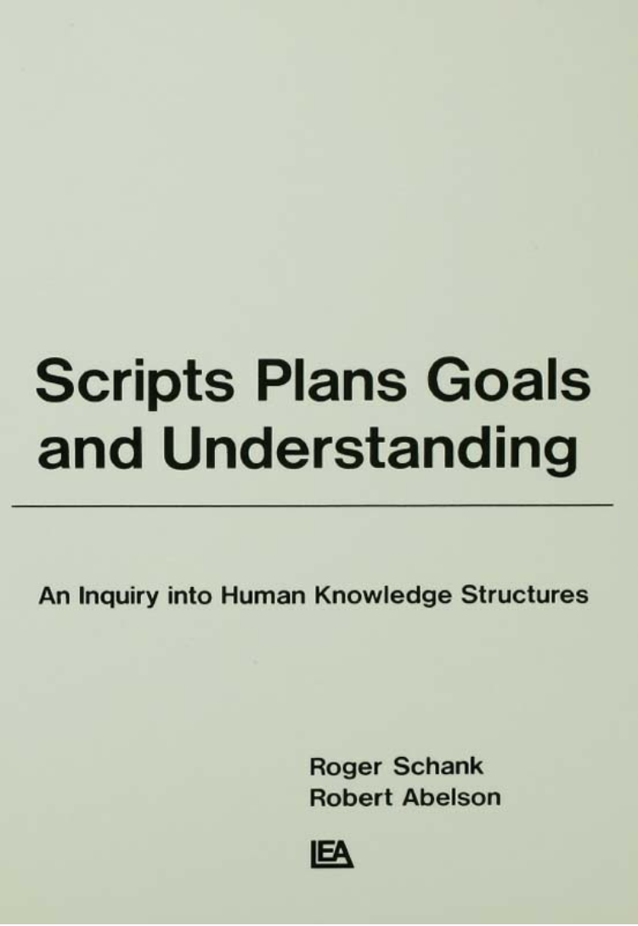
Scripts
How do people organize all the knowledge they must have in order to understand? How do people know what behavior is appropriate for a particular situation?
Scripts consist of prototypical sequences of sub-events, participants, and their roles.
The strong expectations provided by these scripts can help with the classification of entities, the assignment of entities into roles and relations.
Most critically scripts can be used to draw inferences that fill in things that have been left unsaid.

Slide 28
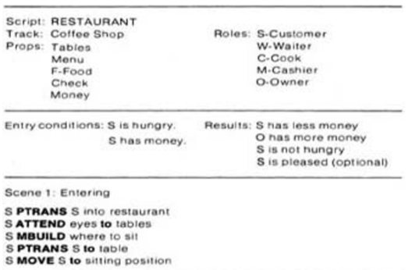
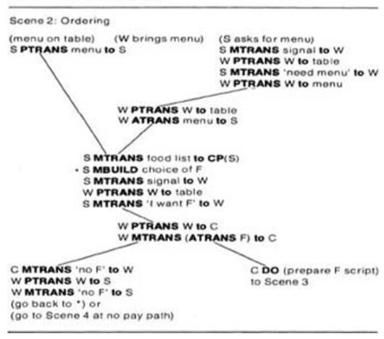

Slide 29
Prosecution Chain
Employment Chain
Notes:
Arrows indicate the before relation.
Dotted lines indicate incorrect before relations.

Slide 30
Narrative Cloze Test
A cloze test removes words from a text and asks the participant to fill in the missing language item. Cloze tests require the ability to understand context and vocabulary in order to identify the correct language or part of speech that belongs in the deleted passages. This exercise is commonly administered for the assessment of native and second language learning and instruction.
Today, I went to the ________ and bought some milk and eggs. I knew it was going to rain, but I forgot to take my ________, and ended up getting wet on the way.

Slide 31
Narrative Cloze Task
Narrative Cloze Task
event₁ event₂ ________ event₄ … event_{n}
What word should fill in the gap?
take → nsubj
tell → nsubj
see → nsubj
…
persuade → dobj
sail → nsubj
regard → dobj
Event vocabulary

Slide 32

Template Filling
Templates represent scripts with a fixed set of slots that take slot-filler values
Train two separate supervised systems
Template recognition
Role-filler extraction
Most earlier systems were based on handwritten regular expressions and grammar rules.

Slide 33
The Gun Violence Database
http://gun-violence.org/
Ellie Pavlick and Chris Callison-Burch, University of Pennsylvania

Slide 34
Goals of the GVDB
Collect data about gun violence in the US to facilitate public health research.
Draw sample from local newspapers and television stations that publish online.
Use machine learning and crowdsourcing to extract structured data from text.

Slide 35
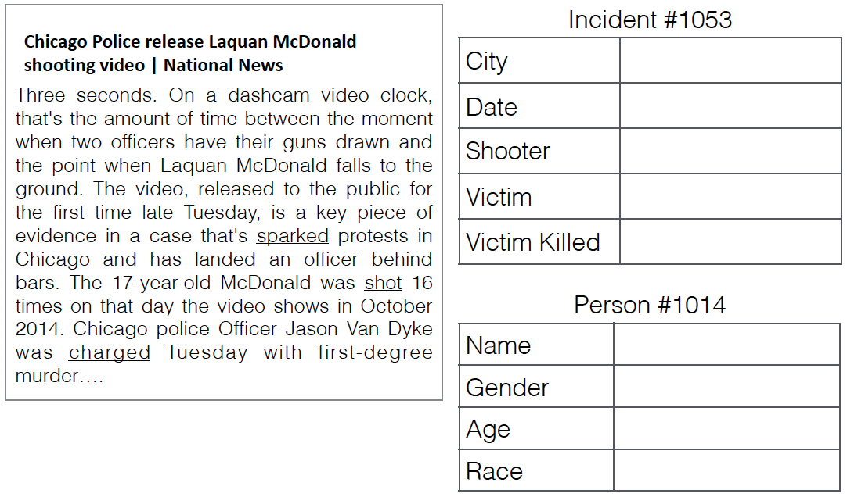
GVDB Template

Slide 36
Semantic Role Labeling
Jurafsky and Martin Chapter 20

Slide 37
Events and their Participants
A purchasing event and its participants can be described by a wide variety of surface forms.
XYZ corporation bought the stock.
They sold the stock to XYZ corporation.
The stock was bought by XYZ corporation.
The purchase of the stock by XYZ corporation...
The stock purchase by XYZ corporation...
Commonality: there was a purchase event, the participants were XYZ Corp and some amount of stock, and XYZ Corp was the buyer.
Semantic Role Labels give a shallow semantic representation of the event and its arguments.
Notes:
The event can be described by a verb (sold, bought) or a noun (purchase), and XYZ Corp can be the syntactic subject (of bought), the indirect object (of sold), or in a genitive or noun compound relation (with the noun purchase) despite having notionally the same role in all of them:

Slide 38
Semantic Roles
Last time we discussed neo-Davidsonian event representations.
Sasha broke the window
∃e, x, y Breaking(e) ∧ Breaker(e, Sasha) ∧BrokenThing(e,y)∧Window(y)
Pat opened the door.
∃e,x,y Opening(e)∧Opener(e,Pat) ∧OpenedThing(e,y)∧Door(y)
The semantic role of the subject of the break is Breaker
The semantic of the subject of the open is Opener
These deep roles are specific to each event.

Slide 39
Thematic Roles
Breakers and Openers have something in common. They are both volitional actors, usually animate, and they have a direct causal responsibility for their events.
Thematic roles are a way to capture this semantic commonality between these roles. In this case, both Breakers and Openers fill the thematic role of AGENT.
AGENT is the thematic role that represents an abstract idea such as volitional causation.
BrokenThing and OpenedThing, are both prototypically inanimate objects that are affected in some way by the action. The semantic role for participant most directly affected by an event is THEME ;

Slide 40
Thematic Roles
Thematic Role | Definition
AGENT | The volitional causer of an event
EXPERIENCER | The experiencer of an event
FORCE | The non-volitional causer of the event
THEME | The participant most directly affected by an event
RESULT | The end product of an event
CONTENT | The proposition or content of a propositional event
INSTRUMENT | An instrument used in an event
BENFICIARY | The beneficiary of an event
SOURCE | The origin of the object of a transfer event
GOAL | The destination of an object of a transfer event

Slide 41
Thematic Roles
Thematic Role | Definition
AGENT | The player kicked the ball.
EXPERIENCER | Dan has a cough and a fever.
FORCE | The coronavirus spread rapidly through the country
THEME | The wind blows debris from the street into our yard
RESULT | The city implemented a stay-at-home policy for non-essential personnel
CONTENT | Chris asked “You met Rebecca at a supermarket?”
INSTRUMENT | He poached catfish, stunning them with a shocking device…
BENFICIARY | Joe makes hotel reservations for his boss.
SOURCE | I flew in from Boston.
GOAL | I drove to Portland.

Slide 42
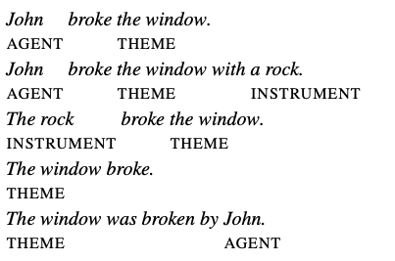
Verb Alternation
Semantic roles act as a shallow meaning representation that allow systems make simple inferences that aren’t possible from the surface string of words, or from the parse tree.
Arguments for verbs alternate in their positions, which makes pure surface analysis difficult.

Slide 43
Problems with Thematic Roles
Analysis of thematic roles should be useful for handling verb alternation. However, there is no single, standard set of thematic roles.
And it’s quite difficult to come up with a formal definition for things like AGENT, THEME, or INSTRUMENT.
For example, there are two kinds of INSTRUMENTS, intermediary instruments that can appear as subjects and enabling instruments that cannot:
The cook opened the jar with the new gadget. The new gadget opened the jar.
Shelly ate the sliced banana with a fork. *The fork ate the sliced banana.
Different theories of thematic roles treat these differently, which causes fragmentation across theories.

Slide 44
Generalized Semantic Roles
Instead of creating a more fine-grained inventory of Thematic Roles, research in NLP has shifted in the direction of coarser roles.
You may see terms like PROTO-AGENT and PROTO-PATIENT, which are generalized roles that express roughly agent-like and roughly patient-like meanings. These meanings are defined a set of heuristics.
A second direction that NLP goes in is to define semantic roles that are specific to each verb, or to a group of semantically related verbs or nouns.
Lexical resources that make use of this second direction are PropBank and FrameNet.

Slide 45
PropBank
PropBank, is a resource of Penn TreeBank sentences annotated with semantic roles. It was created by Martha Palmer at UPenn.
Because defining universal thematic roles is difficult, PropBank defines semantic roles for each verb sense.
Each verb has a specific set of roles, given by numbers: Arg0, Arg1, Arg2.
In general, Arg0 represents the PROTO-AGENT, and Arg1, the PROTO-PATIENT.
Martha Palmer

Slide 46
PropBank Frame File
Agree.01
Arg0: Agreer Arg1: Proposition Arg2: Other entity agreeing
Example 1: [Arg0 The group] agreed [Arg1 it wouldn’t make an offer]. Example 2: [ArgM-TMP Usually] [Arg0 Chris] agrees [Arg2 with Ellie] [Arg1 on everything].
Glosses to be read by humans

Slide 47
PropBank Frame File
Fall.01 Arg1: Logical subject, patient, thing falling Arg2: Extent / amount fallen Arg3: Start point Arg4: End point
Example 1: [Arg1 Sales] fell [Arg4 to $25 million] [Arg3 from $27 million].
Example 2: [Arg1 The average junk bond] fell [Arg2 by 4.2%].
Notes:
Note that there is no Arg0 role for fall, because the normal subject of fall is a PROTO-PATIENT.

Slide 48
PropBank Frame File
Increase.01 “go up incrementally” Arg0: Causer of increase Arg1: Thing increasing Arg2: Amount increased by Arg3: Start point Arg4: End point
Example 1: [Arg0 Big Fruit Co. ] increased [Arg1 the price of bananas]. Example 2: [Arg1 The price of bananas] was increased again [Arg0 by Big Fruit Co. ] Example 3: [Arg1 The price of bananas] increased [Arg2 5% ].
Notes:
A PropBank semantic role labeling would allow us to infer the commonality in the event structures of the following three examples, that is, that in each case Big Fruit Co. is the AGENT and the price of bananas is the THEME, despite the differing surface forms.

Slide 49
ArgMs
PropBank also has a number of non-numbered arguments called ArgMs, which represent modification meanings. These are stable across predicates, so aren’t listed with each frame file

Slide 50
FrameNet
In order to make semantic inferences about price increase events, we want to make the connection across many different verbs, not just the verb increase.
Example 1: [Arg1 The price of bananas] increased [Arg2 5% ]. Example 2: [Arg1 The price of bananas] rose [Arg2 5% ]. Example 3: There has been a [Arg2 5% ] rise in [Arg1 the price of bananas]
FrameNet is another Semantic Role Labeling project that attempts to address just these kinds of problems.
PropBank labels roles specific to an individual verb, and FrameNet labels roles are specific to a frame.

Slide 51
Frames
What is a frame? Consider the following set of words:
reservation, flight, travel, buy, price, cost, fare, rates, plane
They form coherent chunk of common-sense background information concerning air travel. The background knowledge that unites these words a frame.
The idea that groups of words are defined with respect to some back- ground information is widespread in AI and cognitive science. Similar to the notion of a script that we saw before.

Slide 52
Frame Elements
Frame: Change position on a scale

Slide 53
Lexical Units
Lexical Units that trigger the change position on a scale frame

Slide 55
Semantic Role Labeling
SRL is the task of automatically finding the semantic roles of each argument of each predicate in a sentence.
Most state-of-the-art approaches to SRL use supervised machine learning, with FrameNet and PropBank providing training and test sets and defining what counts as a predicate and what the roles are.

Slide 56
Primitive Decomposition of Predicates
One way of thinking about semantic is that they help us define the roles that arguments play in a decompositional way, based on finite lists of thematic roles.
Jim killed his philodendron. Jim did something to cause his philodendron to become not alive. KILL(x,y) ⇔ CAUSE(x, BECOME(NOT(ALIVE(y))))
John opened the door. ⇒ CAUSE(John, BECOME(OPEN(door)))
The door opened. ⇒ BECOME(OPEN(door))
The door is open. ⇒ OPEN(door)

Slide 57
Conceptual dependency primitives

Slide 58
Neo-Davidsonian Event with Primatives
The waiter brought Mary the check.
∃x,y Atrans(x)∧Actor(x,Waiter)∧Object(x,Check)∧To(x,Mary) ∧Ptrans(y)∧Actor(y,Waiter)∧Object(y,Check)∧To(y,Mary)

Slide 59
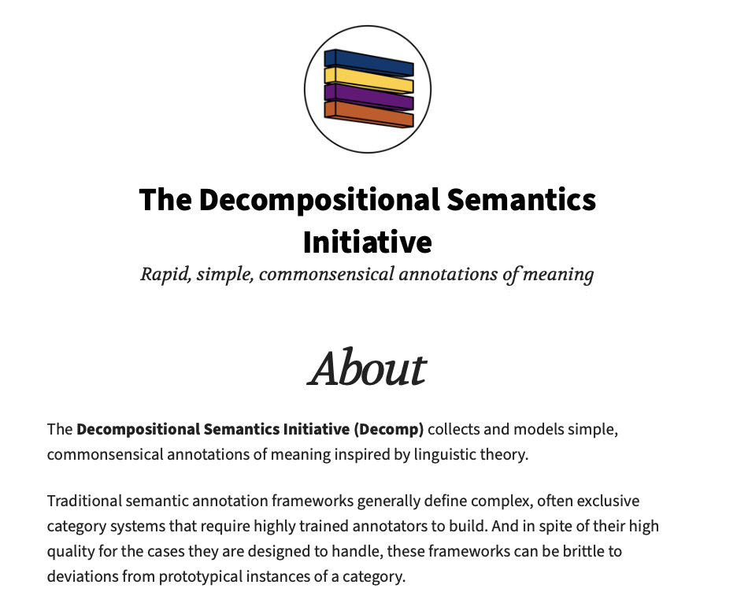
http://decomp.io

Slide 60
Conclusions
Semantic roles are abstract models of the role an argument plays in the event described by the predicate.
Thematic roles are a model of semantic roles based on a single finite list of roles.
Per-verb semantic role lists and proto-agent/proto-patient, are implemented in PropBank and FrameNet.
Semantic role labeling is the task of assigning semantic role labels to the constituents of a sentence.
Cool new research directions in finding event primatives.

